Slide 1
Chapter 14
Chapter Review

Slide 2
Four main approaches to studying personality
Psychodynamic
Trait
Learning
Humanistic

Slide 3
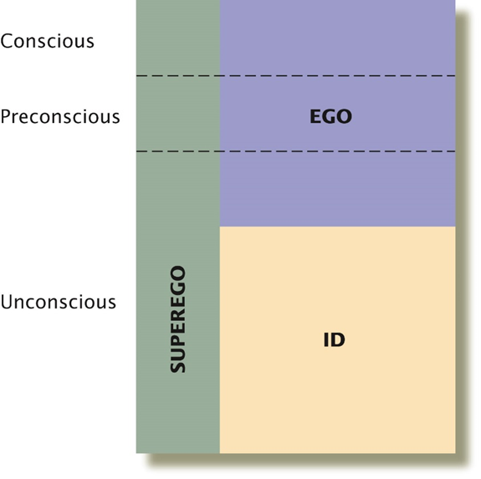
Freud: Id, Ego, Superego
Id
Operates on pleasure principle
Ego
Operates on reality principle
Guides sensible actions
Superego
Moral imperatives

Slide 4
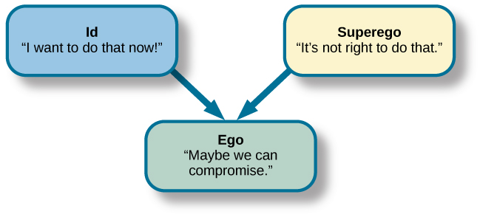
Strong ego = healthy personality
Imbalances can lead to neurosis, anxiety disorders, or unhealthy behaviors

Slide 5
Freud: Psychosexual stages
Oral Stage: mouth is the center of pleasure and conflict
Anal Stage: pleasure and conflicts shift from mouth to anus
Phallic Stage
Boys: Oedipal complex
Girls: Electra complex
Latency Period
Sexual desires are dormant
Genital Stage: sexual desires reappear at conscious level

Slide 6
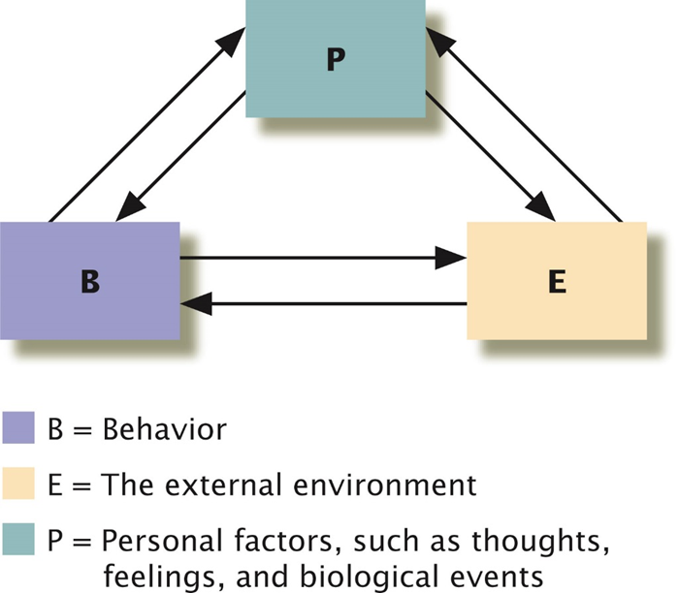
Bandura’s Reciprocal Determinism
Ongoing interaction between personal factors, behavior, and the environment
Self-efficacy: learned expectations about the probability of success in given situations.

Slide 7
Rotter’s Expectancy Theory
Behavior is guided by learned expectancies
Engaging in a behavior is determined by:
Expectations of a behavior’s outcome
Value placed on that outcome
Control orientation
Internals expect to control events, leading to better outcomes in many aspects of life
Externals expect to be controlled by outside forces

Slide 8
Trait approach: Big Five
Openness to experience
Conscientiousness
Extraversion
Agreeableness
Neuroticism

Slide 9
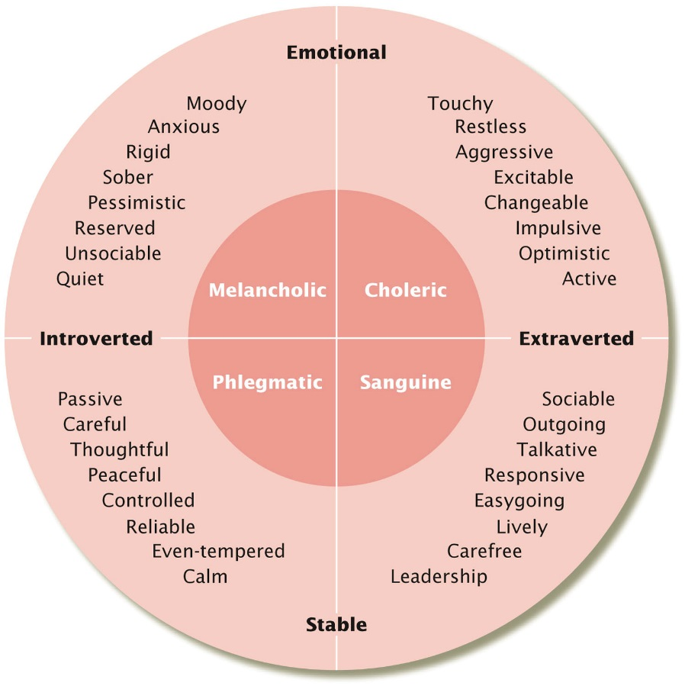
Biological Trait Theories: Hans and Sybil Eysenck
Based on inherited differences in the nervous system
Two dimensions
Introversion-extraversion
Need for arousal
Emotional stability
Sensitivity to stress
Notes:
9

Slide 10
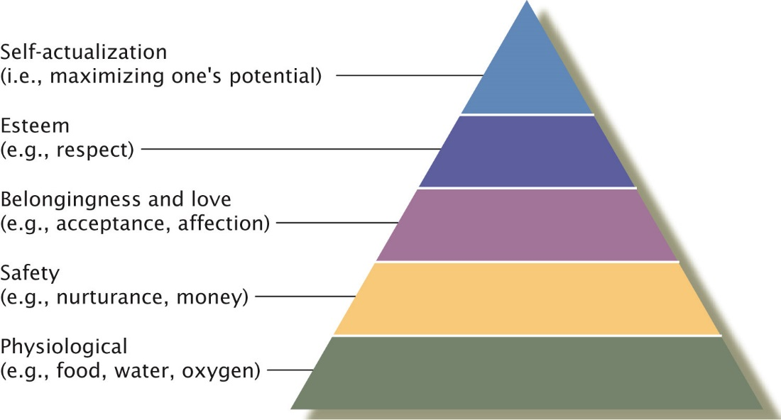
Maslow’s Growth Theory
Deficiency orientation: Focus on what’s missing
Growth orientation: Focus on satisfactions in life

Slide 11
Assessing Personality
Projective tests: designed to capture unconscious impulses; less reliable and valid (e.g., Rorschach Inkblot Test)
Nonprojective tests: efficient, standardized; subject to faking (e.g., NEO-PI-R for Big Five, MMPI)

